Slide 1
Front End Engineering Project
TEAM DETAILS:
GAURAV GARG (2210990318)
ESHAAN GARG (2210990308)
DIVYA PURI (2210990294)
Under the supervision
Of
Mr.Vikas and Ms.Parul Gehlot
Name of Department/School
Chitkara University, Punjab

Slide 2
Introduction
Introduction regarding the background of the project area/proposed problem
It’s a list of tasks you need to complete or things you want to do .
One of the most important reasons you should use a to do list is that it will help you stay organised .
This gives you a sense of progress and achievement, something you’ll lack if you’re always rushing from one task to the next.

Slide 3
Motivation of Research
Motivation Behind The Work
Increases productivity -This allows you to organize and complete the most crucial tasks first. To-do lists can be used to improve time management because all of your tasks are laid out clearly in advance.
Provides motivation - Too many tasks to remember can be overwhelming, but with the proper motivation, you can accomplish more and reduce stress. Having a to-do list makes it easier to organize everything that you want to accomplish in the day so that you can start fresh the next.

Slide 4
Tools & Technologies
HTML:
The project utilizes HTML (Hypertext Markup Language) as the foundational markup language for creating the structure and content of web pages.
JavaScript:
JavaScript is employed for dynamic and interactive elements within the app. It facilitates real-time updates, user interactions, and seamless integration with the Polygon API.
CSS (Cascading Style Sheets):
CSS is used for styling and layout purposes, ensuring a visually appealing and responsive user interface. It contributes to the overall design and presentation of the app.

Slide 5
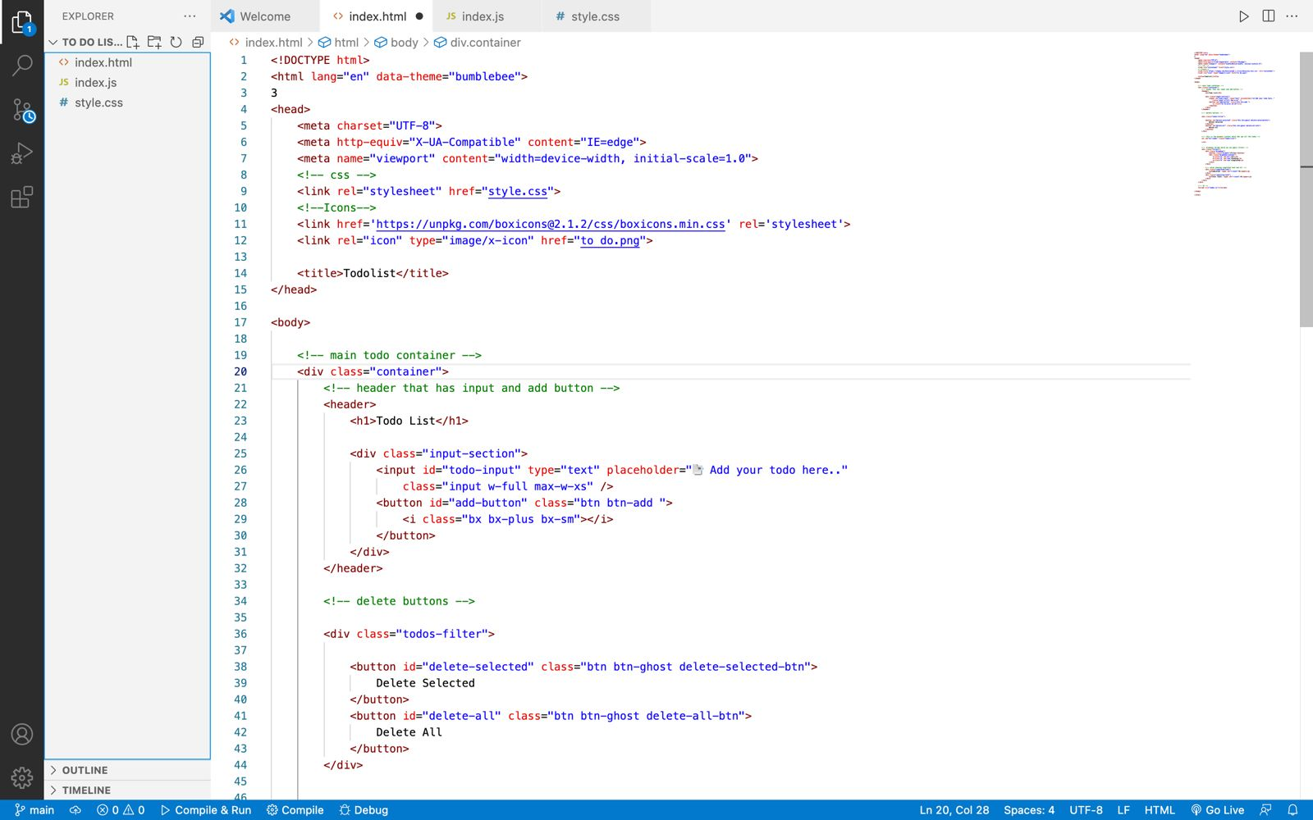
Code Snapshots

Slide 6
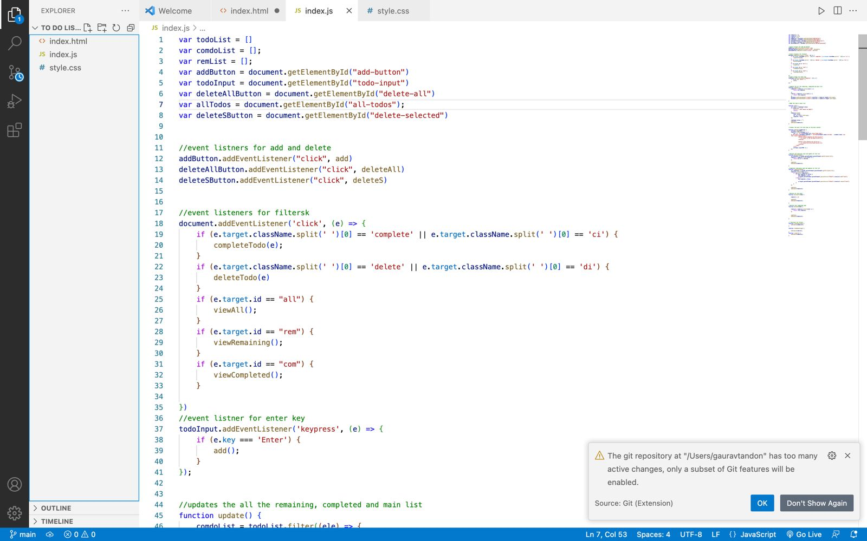
Snapshots

Slide 7
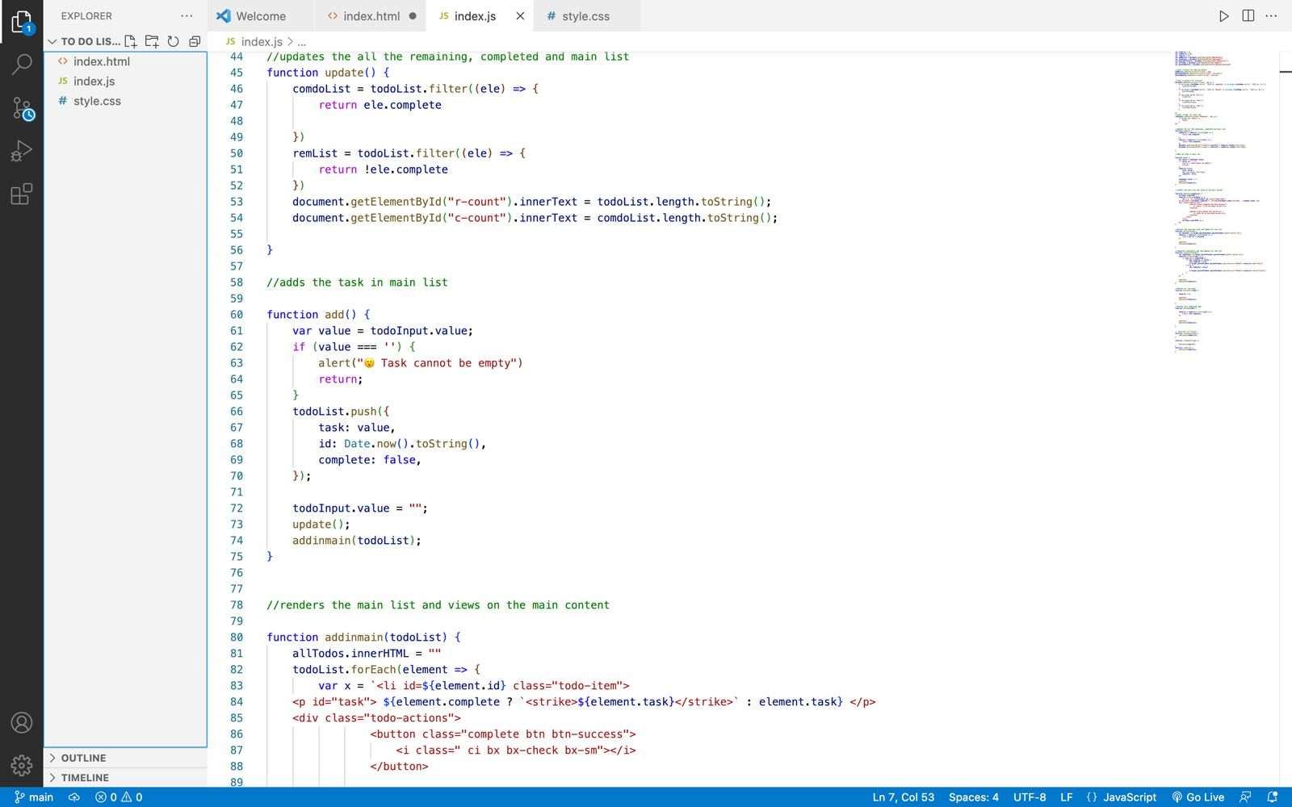
Snapshots

Slide 8
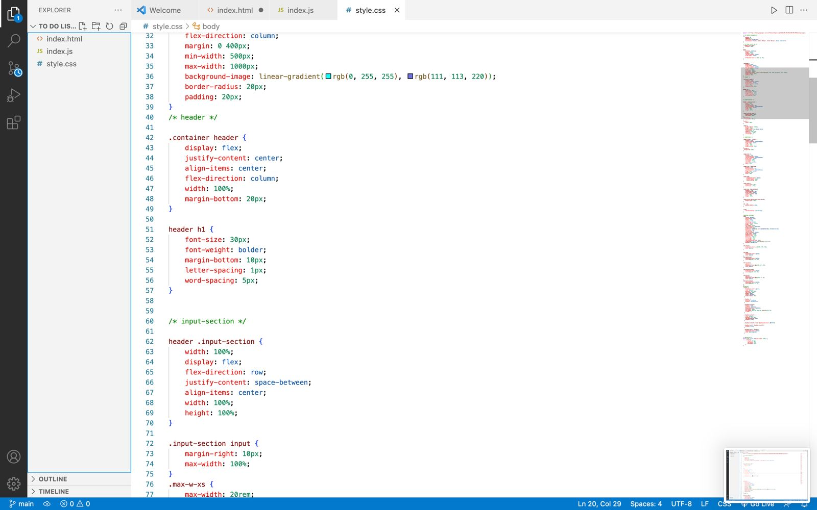
Snapshots

Slide 9
Conclusion/Theme Plan
For many people, trying to be more productive and meet deadlines can feel like a constant juggling act. However, there is a simple way to navigate the confusion and complete tasks more efficiently—a to-do list. This type of list can help you keep track of all upcoming tasks so you can systematically handle each at a time and not forget anything important.

Slide 10
References
List of key references here for your study
https://chat.openai.com/
https://www.w3schools.com

Slide 11
.
THANK YOU

